Slide 1


Stage III and IV
Malignant Melanoma
Jennifer Carter 09/12/17

Slide 2

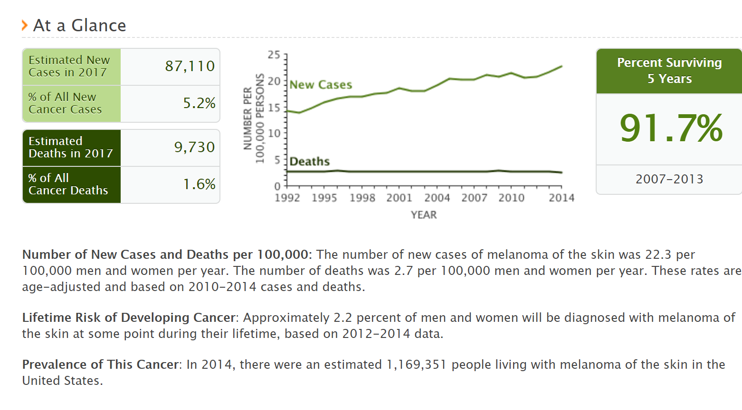
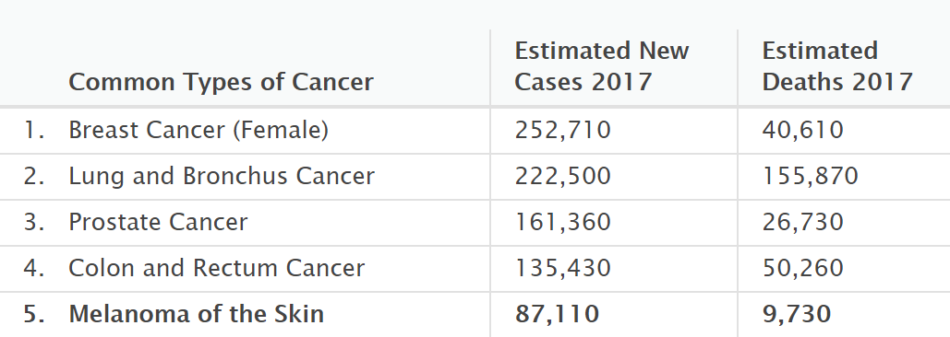
https://seer.cancer.gov/statfacts/html/melan.html
MALIGNANT MELANOMA

Slide 3
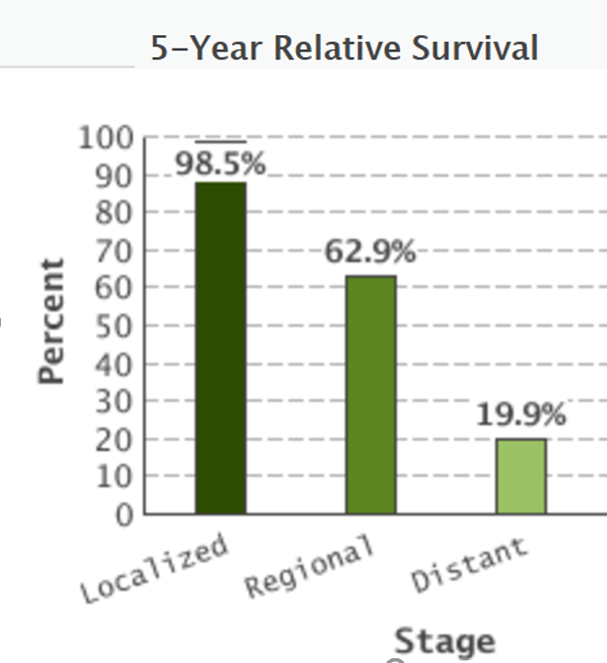




Slide 4

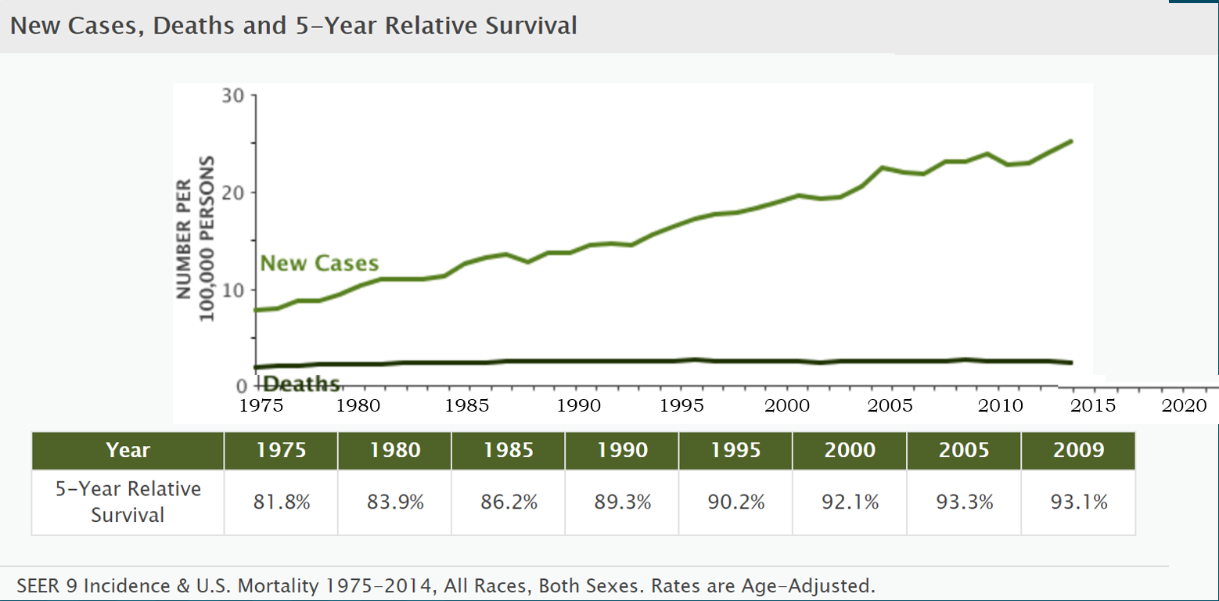

New Cases, Deaths and 5-year Relative Survival
Dabrafenib and Trametinib
High dose interferon
Pembrolizumab
Dacarbazine
Nivolumab
Vemurafenib
and
Cobimetinib
High dose IL-2 (Aldesleukin)
Ipilimumab

Slide 5
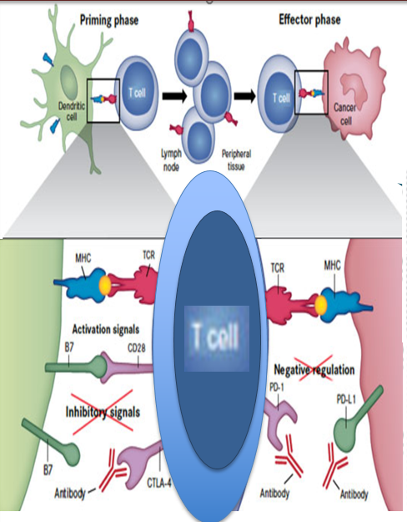
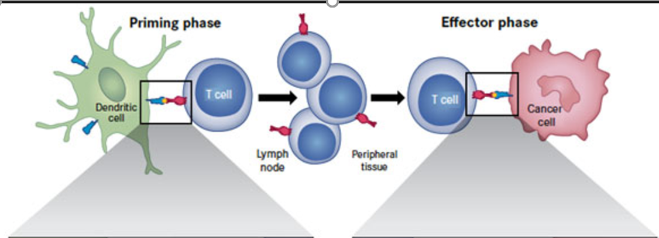

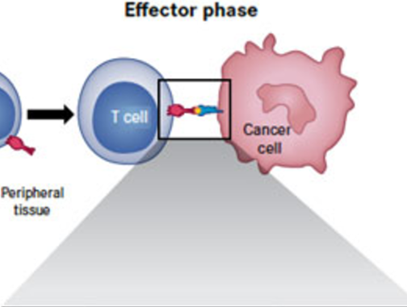
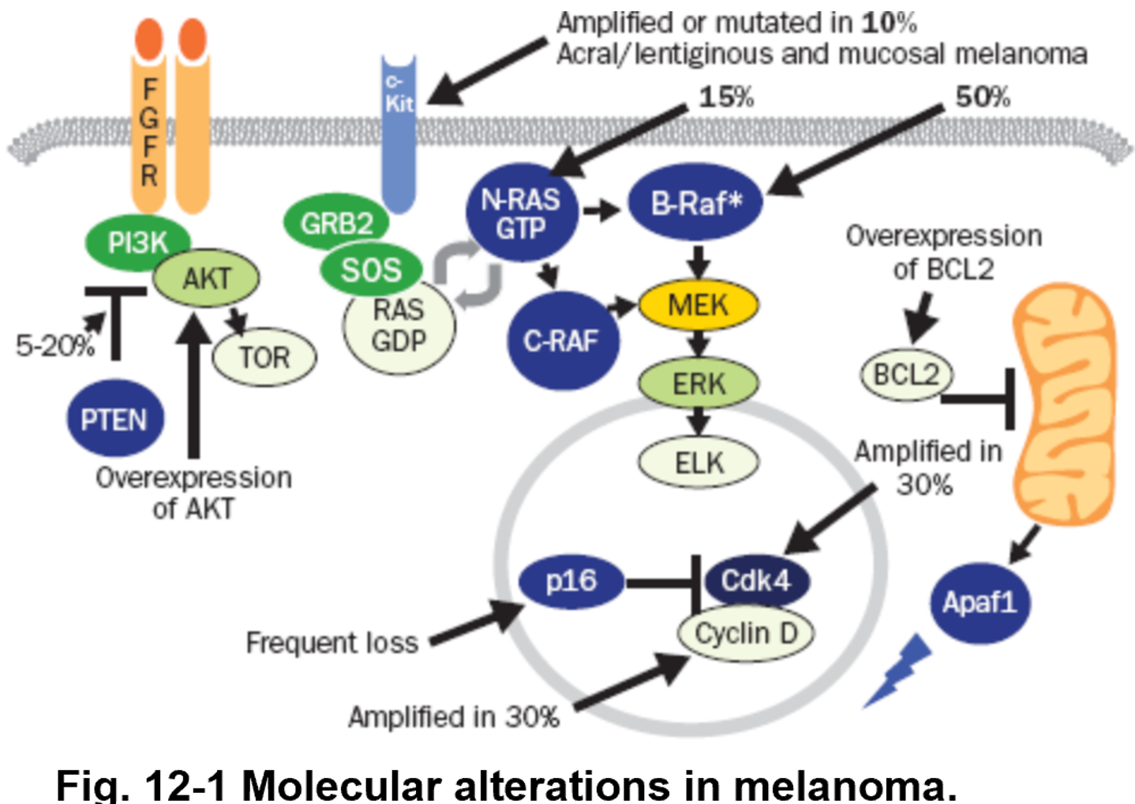


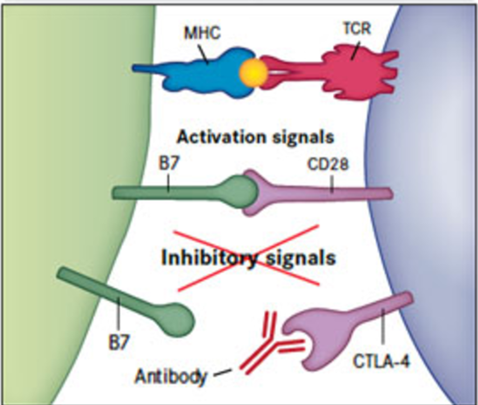
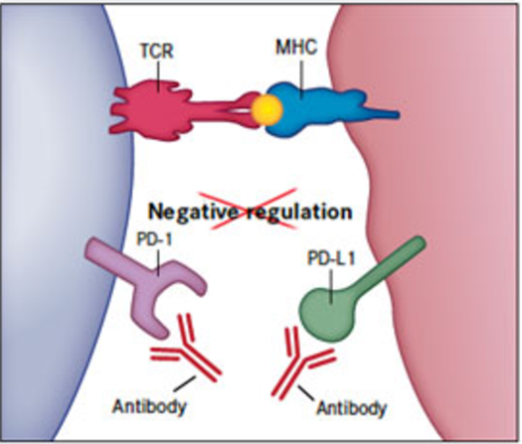

N-RAS (15-20%) and BRAF (50%) mutation
Vast majority are BRAF V600E mutation
Glutamic acid change at codon 600
Second most common is BRAF V600K
Overexpression of BCL2
Overexpression of BCL2
Genetic susceptibility to melanoma:
Gene on chromosome 9p21: p16/CDKN2A
Encodes for two proteins: p16 and p14ARF
In pts who have strong family history of melanoma, 25%-40% carry this mutation and have a 30-90% risk of developing melanoma by age 80
Genetic susceptibility to melanoma:
Gene on chromosome 9p21: p16/CDKN2A
Encodes for two proteins: p16 and p14ARF
In pts who have strong family history of melanoma, 25%-40% carry this mutation and have a 30-90% risk of developing melanoma by age 8
0
Genetic susceptibility to melanoma:
Gene on chromosome 9p21: p16/CDKN2A
Encodes for two proteins: p16 and p14ARF
25%-40% of pts who have strong family history of melanoma have been found to carry this mutation
If positive, it portrays a 30-90% risk of developing melanoma by age 80
Amplified or mutated c-Kit, which is found in 10% of acral/letiginous and mucosal melanomas
Amplified or mutated c-Kit, which is found in 10% of acral/letiginous and mucosal melanomas
Amplification of Cdk4 (30%) or Cyclin D (30%)
Amplification of Cdk4 (30%) or Cyclin D (30%)
Activation of the P13K pathway, often through loss of PTEN through inactivating missense mutations or allele deletion.
Activation of the P13K pathway, often through loss of PTEN through inactivating missense mutations or allele deletion.

Slide 6
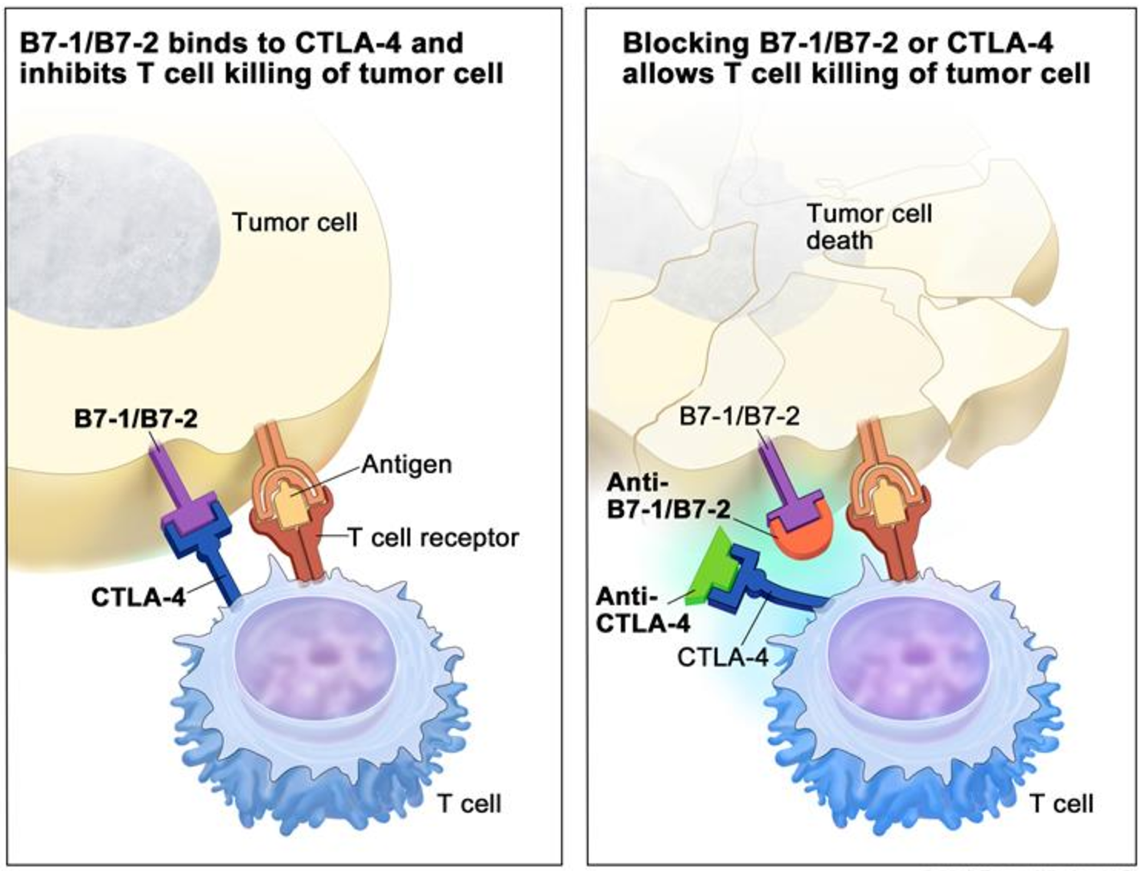
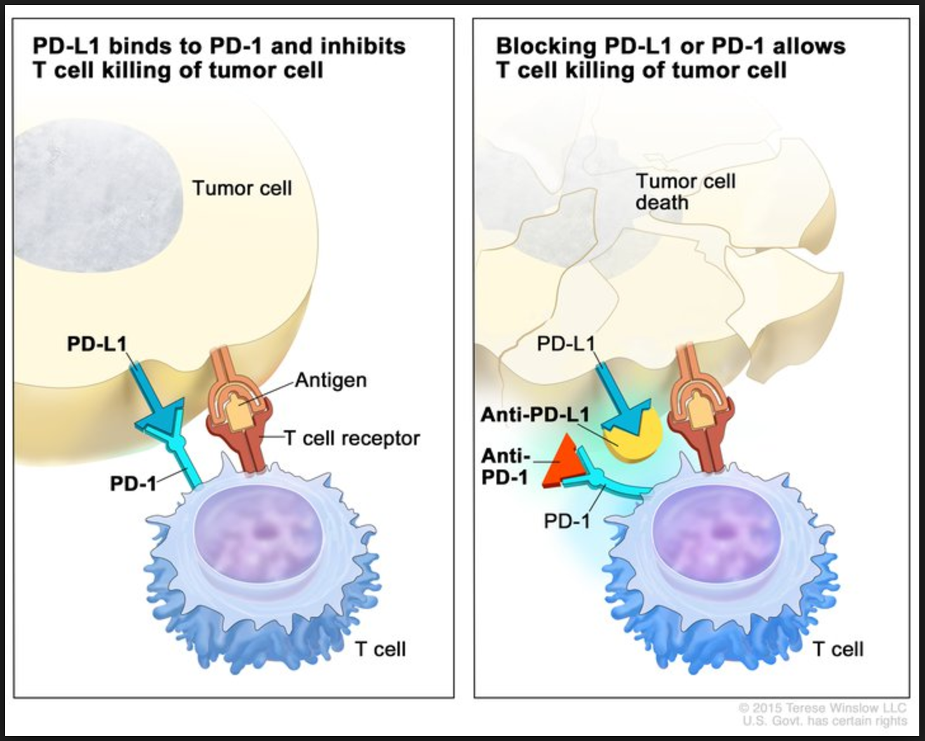
PD-1 inhibitors
CTLA-4 inhibitors
“No one should die in the country without getting a whiff of PD-1 inhibitor” ~well known Hematology Oncology physician

Slide 7









Slide 8
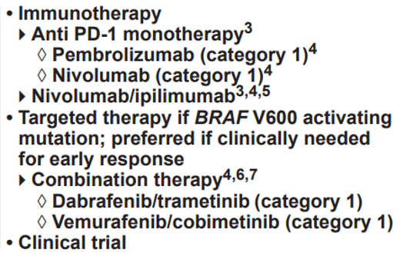
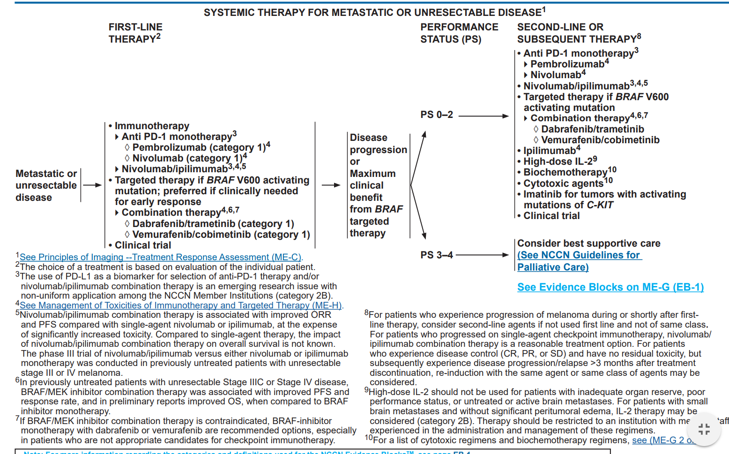

Slide 9
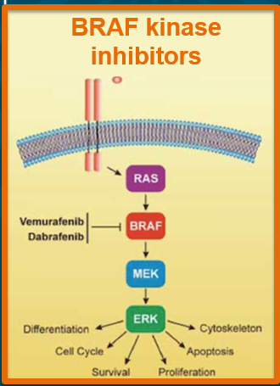
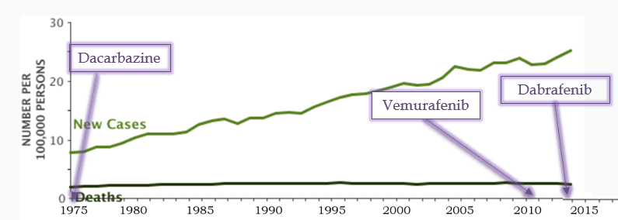
Vemurafenib and Dabrafenib
BRAF kinase inhibitors
FDA approved in 2011 (Vemurafenib) 2014 (Dabrafenib) for unresectable or metastatic stage III or IV melanoma:
Vemurafenib:
Sosman 2012 NEJM “Survival in BRAF V600-mutant advanced melanoma treated with vemurafenib”
Chapman 2011 NEJM “Improved survival with vemurafenib in melanoma with BRAF V600E mutation;, McArthur 2014 Lancet “Safety and efficacy of vemurafenib in BRAF V600E and BRAF V600K mutation positive melanoma BRIM 3 extended follow up of a phase 3 randomized open label study”
Larkin 2014 Lancet “Vemurafenib in patients with BRAF V600 mutated metastatic melanoma an open label multicenter safety study”
Dabrafenib:
-Ascierto 2013 JCO “Phase II trial BREAK 2 of the BRAF inhibitor dabrafenib in patients with metastatic melanoma”
-Long 2012 Lancet “Dabrafenib in patients with Val600Glu or Val600Lys BRAF-mutant melanoma metastatic to the brain BREAK-MB a multicenter, open-label, phase 2 trial”
-Hauschild 2012 Lancet “Dabrafenib in BRAF-mutated metastatic melanoma a multicentre, open-label, phase 3 randomised controlled trial”

Slide 10

Treatment Arms | Response rate | Onset of response | PFS | OS | Grade 3-5 AE
Survival in BRAF V600E (8% had V600K)-mutant advanced melanoma treated with Vemurafenib. A phase II study with previously treated metastatic melanoma.
Vemurafenib 960mg BID (132 pts) | 53% (44-62%) *6% CR 40% with V600K | Not reported | 6.8 months (5.6-8.1) | 15.9 months (11.6-18.3) | 64%
Sosman 2012 NEJM “Survival in BRAF V600-mutant advanced melanoma treated with vemurafenib”
BRIM-3: Phase III RCT with untreated, metastatic melanoma, with BRAF V600E mutation (9% had V600K)
Vemurafenib 960mg BID (337 pts) Dacarbazine 1000mg/m2 q3w (338 pts) | 48% (p<0.001)* *6% CR 5% (p<0.001)* **1% CR | 1.4 months (IQR 1.3-1.6) 3.0 months (IQR 2.7-6.3) | 6.9 months (p<0.0001) 1.6 months (p<0.0001) | 13.6 months (p=0.0008) 9.7 months (p=0.0008) | 73% 44%
-Chapman 2011 NEJM “Improved survival with vemurafenib in melanoma with BRAF V600E mutation -McArthur 2014 Lancet “Safety and efficacy of vemurafenib in BRAF V600E and BRAF V600K mutation positive melanoma BRIM 3 extended follow up of a phase 3 randomized open label study”
Vemurafenib in patients with BRAF V600 mutated metastatic melanoma: phase IV, open-label, multi-center safety study. Half of pts had received prior treatment.
Vemurafenib (3222 pts) | 34% *3% CR | Not reported | 5.6 months | 12.0 months | 51%
Larkin 2014 Lancet “Vemurafenib in patients with BRAF V600 mutated metastatic melanoma an open label multicenter safety study”
”

Slide 11
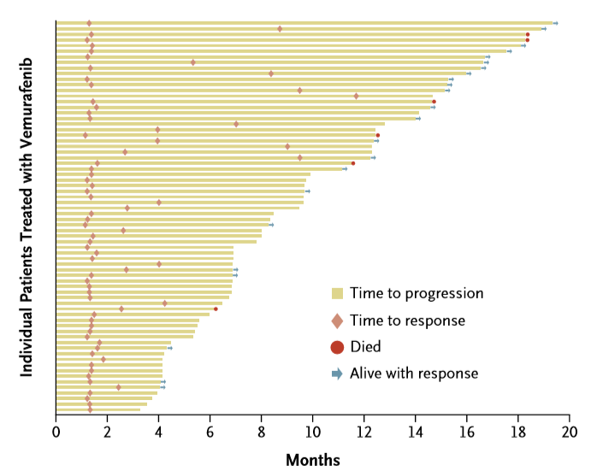
Sosman 2012 NEJM “Survival in BRAF V600-mutant advanced melanoma treated with vemurafenib”

Slide 12

Treatment Arms | Response rate | Onset of response | PFS | OS | Grade 3-4 AE
BREAK-2: Phase II of the BRAF inhibitor (17% BRAF V600K) Dabrafenib in patients with metastatic melanoma excluded brain metastasis
Dabrafenib 150 mg BID (92 pts) | 59% (48.2-70.3%) *7% CR | 1.3 months | 6.3 months (BRAF V600E) 4.5 months (BRAF V600K) | 13.1 months (BRAF V600E) 12.9 months (BRAF V600K) | 27%
Ascierto 2013 JCO “Phase II trial BREAK 2 of the BRAF inhibitor dabrafenib in patients with metastatic melanoma”
BREAK-MB: Phase II, Dabrafenib in patients with Val600Glu (81% BRAF V600E) mutation or Val600Lys (19% BRAF V600E) mutation with metastatic melanoma and 100% patients with brain metastasis. Separated into previously untreated and previously treated brain metastasis
Untreated Dabrafenib 150 mg (89 pts) Treated Dabrafenib 150 mg (83 pts) | 39.2% (0-51.2%) *3% CR →7% (0-32%) V600E 30.8% (19.9-43.4%) *0% CR →22% (6-48%) V600E | Not reported | 3.7 months →1.8 months V600E **not significant 3.8 months →3.6 months V600E **not significant | 7.6 months →3.7 months V600E **significant 7.2 months →4.9 months V600E **not significant | 22%
Long 2012 Lancet “Dabrafenib in patients with Val600Glu or Val600Lys BRAF-mutant melanoma metastatic to the brain BREAK-MB a multicenter, open-label, phase 2 trial”
BREAK-3: Phase III, Dabrafenib in BRAF V600E-mutated unresectable stage III or IV melanoma without brain metastasis
3:1 Dabrafenib (187 pts) 3:1 Dacarbazine (63 pts) | 50% (p<0.001)* *3% CR 5% (p<0.001)* *2% CR | 1.5 months Not reported | 5.1 months (p<0.0001) 2.7 months (p<0.0001) | 18.2 months (HR 0.61 CI 0.25-1.48) 15.6 months (HR 0.61 CI 0.25-1.48) | 53% 44%
Hauschild 2012 Lancet “Dabrafenib in BRAF-mutated metastatic melanoma a multicentre, open-label, phase 3 randomised controlled trial”
”

Slide 13
SIDE EFFECTS:
ANY adverse events
→53%
Hyperkeratosis (15%)
Fever (11%)
Hand-foot (8%)
Squamous cell carcinoma (6%)
Arthralgia (5%)
Fatigue (5%)
Nausea/vomiting (2%)
Grade 3 or 4 adverse events
→22%
Squamous cell carcinoma (4%)
Hand foot (2%)
Fever (3%)
Hauschild 2012 Lancet “Dabrafenib in BRAF-mutated metastatic melanoma a multicentre, open-label, phase 3 randomised controlled trial”
SIDE EFFECTS:
ANY adverse events
→95%
Rash (48%)
Arthralgia (38%)
Fatigue (32%)
Alopecia (26%)
Nausea (19%)
Hyperkeratosis (19%)
Diarrhea (15%)
Grade 3 or 4 adverse events
→46%
Squamous cell carcinoma (12%)
Rash (5%)
Liver function abnormalities (5%)
Rash (5%)
Larkin 2014 Lancet “Vemurafenib in patients with BRAF V600 mutated metastatic melanoma an open label multicenter safety study”

Slide 14
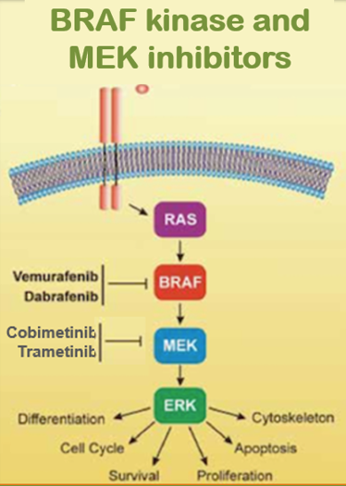
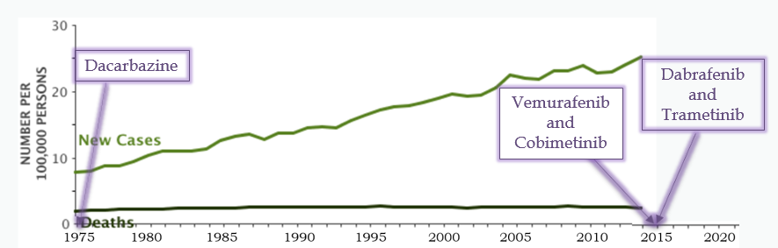
Vemurafenib/Cobimetinib
Dabrafenib/Trametinib
BRAF kinase inhibitors/MEK inhibitors
FDA approved in 2015 (Vemurafenib/Cobimetinib) and 2015 (Dabrafenib/Trametinib) for unresectable or metastatic stage III or IV melanoma based on :
Vemurafenib/Cobometinib
-Ribas 2014 Lancet “Combination of vemurafenib and cobimetinib in patients with advanced BRAF V600 mutated melanoma a phase 1b study”
-Larkin 2014 NEJM “Combined vemurafenib and cobimetinib in BRAF-mutated melanoma”
Dabrafenib/Trametinib
-Johnson 2014 JCO “Combined BRAF dabrafenib and MEK inhibition trametinib in patients with BRAFV600 mutant melanoma experiencing progression with single-agent BRAF inhibitor”
-Robert 2015 NEJM “Improved overall survival in melanoma with combined dabrafenib and trametinib”
-Long 2015 Lancet “Dabrafenib and Trametinib versus Dabrafenib and placebo for Val600 BRAF-mutant melanoma a multicenter double blind phase 3 randomized controlled trial”
BRAF kinase and MEK inhibitors

Slide 15
Treatment Arms | Response rate | Onset of response | PFS | OS | Grade 3-5 AE
BRIM-7: Phase 1b, Combination of vemurafenib and cobimetinib in patients with advanced BRAF V600E (7% V600K) mutated melanoma. ~Half of patients had recently progressed on vemurafenib. Applied dose escalation of vemurafenib and cobimetinib
Untreated: Vemurafenib 720→960mg BID/ Cobimetinib 60→80mg daily (63 pts) Treated: Vemurafenib 720→960mg BID/ Cobimetinib 60→80mg daily (33 pts) | 87% (p<0.001)* *10% CR 15% (p<0.001)* *0% CR | 1.4 months 1.5 months | 13.8 months (p<0.0001) 2.8 months (p<0.0001) | 28.2 months (p<0.0001) 2.8 months (p<0.0001) | *reduced dose/did not escalate dose based on grade 3 toxicities, “tolerated dose” was vemurafenib 960mg BID and Cobimetinib 80mg daily
Ribas 2014 Lancet “Combination of vemurafenib and cobimetinib in patients with advanced BRAF V600 mutated melanoma a phase 1b study”
Co-BRIM: Phase III, Combined vemurafenib and cobimetinib in BRAF V600E (11% V600K) -mutated, previously untreated, unresectable locally advanced or metastatic melanoma.
Vemurafenib/Cobimetinib (247 pts) Vemurafenib/Placebo (248 pts) | 68% (p<0.001)* *10% CR 45% (p<0.001)* *4% CR | 1.8 months 1.8 months | 9.9 months (p<0.0001) 6.2 months (p<0.0001) | 81% at 9 months (p=0.046) 73% at 9 months (p=0.046) | 65% 59%
Larkin 2014 NEJM “Combined vemurafenib and cobimetinib in BRAF-mutated melanoma”

Slide 16

Treatment Arms | Response rate | Response duration | PFS | OS | Grade 3-5 AE
Phase I/II Study: Combined BRAF (Dabrafenib) and MEK inhibition (Trametinib) in patients with BRAF V600E (14% V600K) mutant unresectable stage III or IV melanoma experiencing progression with single-agent BRAF inhibitor (Part A-D, A: 1 arm, B: 2 arms, C: 3 arms D: 1 arm)
<6 months since BRAF inhibitor Dabrafenib 75→150mg BID/ Trametinib 1→1.5→2 mg daily (23 pts) >6 months since BRAF inhibitor Dabrafenib 75→150mg BID/ Trametinib 1→1.5→2 mg daily (22 pts) | 0% (0-15%) *0% CR 26% (10-48%) *5% CR | 45% with stable disease lasting >8 weeks 45% with stable disease lasing >8 weeks | 1.8 months (p=0.018) 3.9 months (p=0.018) | 11.8 months (CI 8-25 months) | 51%
Johnson 2014 JCO “Combined BRAF dabrafenib and MEK inhibition trametinib in patients with BRAFV600 mutant melanoma experiencing progression with single-agent BRAF inhibitor”
COMBI-v: Phase III, Improved overall survival with combined Dabrafenib and Trametinib in BRAF V600E (10% V600K) mutant untreated, unresectable stage III or IV melanoma
Dabrafenib 150mg BID/ Trametinib 2mg daily (352 pts) Vemurafenib 960mg BID (352 pts) | 64% (p<0.001)* *13% CR 51% (p<0.001)* *8% CR | 13.8 months (CI 11-NR months) 7.5 months (CI 7.3-9.3 months) | 11.4 months (p<0.0001) 7.3 months (p<0.0001) | 72% at 1 year (p=0.005) 65% at 1 year (p=0.005) | 52% *1% Cutaneous SSC 63% *18% Cutaneous SSC
Robert 2015 NEJM “Improved overall survival in melanoma with combined dabrafenib and trametinib”
COMBI-d: Phase III, Dabrafenib and Trametinib versus Dabrafenib and placebo for V600E (15% V600K) mutant, untreated, unresectable stage III or IV melanoma
Dabrafenib 150mg BID/ Trametinib 2mg daily (211 pts) Dabrafenib 150mg BID/ Placebo (212 pts) | 69% (p=0.0014)* *16% CR 53% (p<0.001)* *13% CR | 12.9 months 10.6 months | 11.0 months (p=0.0004) 8.8 months (p=0.0004) | 25.1 months (p=0.0107) 18.7 months (p=0.0107) | 32% 32%
Long 2015 Lancet “Dabrafenib and Trametinib versus Dabrafenib and placebo for Val600 BRAF-mutant melanoma a multicenter double blind phase 3 randomized controlled trial”

Slide 17


SIDE EFFECTS:
ANY adverse events
→95%
Diarrhea (39%)
Nausea/Vomiting (30%/16%)
Rash (22%)
Arthralgias (21%)
Photosensitivity (19%)
Fatigue (19%)
Fever (19%)
Alopecia (13%)
Grade 3 or 4 adverse events
→62%
Increased liver enzymes (12%)
Diarrhea (6%)
Rash (5%)
Fatigue (4%)
Cutaneous squamous cell (2%)
Larkin 2014 NEJM “Combined vemurafenib and cobimetinib in BRAF-mutated melanoma”
SIDE EFFECTS:
ANY adverse events
→87%
Fever (52%)
Chills (28%)
Fatigue (27%)
Rash (24%)
Nausea (20%)
Headache (19%)
Arthralgias (16%)
Elevated liver enzymes (12%)
Grade 3 adverse events
→32%
Fever (7%)
Elevated liver enzymes (3%)
Cutaneous squamous cell (3%)
Long 2015 Lancet “Dabrafenib and Trametinib versus Dabrafenib and placebo for Val600 BRAF-mutant melanoma a multicenter double blind phase 3 randomized controlled trial”

Slide 18
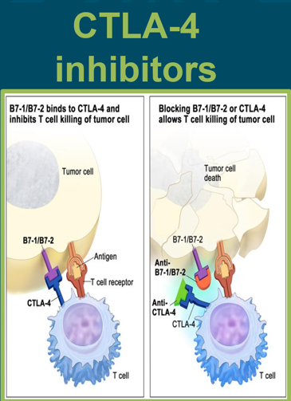
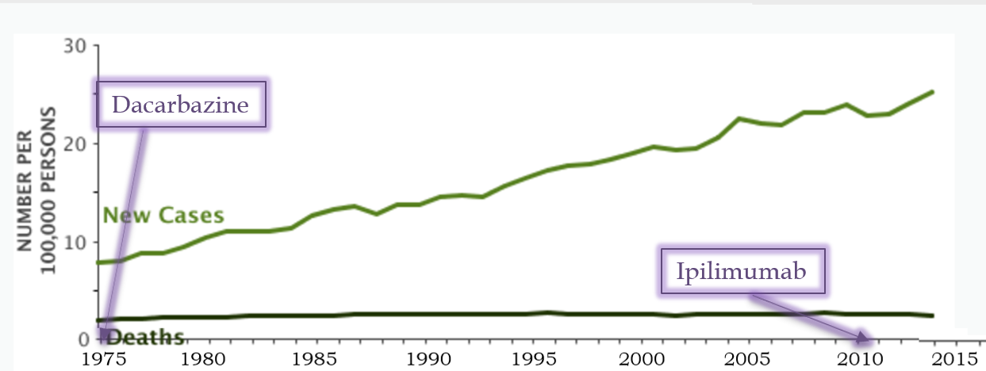
Ipilimumab
Monoclonal antibody (IgG1) used to block the immune checkpoint receptor CTLA-4 and thus allow for the priming and effector phase of T-cell activation against tumor cells
FDA approved in 2011 for unresectable or metastatic stage III or IV melanoma based on two phase III trials:
Hodi 2010 NEJM “Improved survival ipilimumab in patients with metastatic melanoma”
Robert 2011 NEJM “Ipilimumab plus dacarbazine for previously untreated metastatic melanoma”

Slide 19

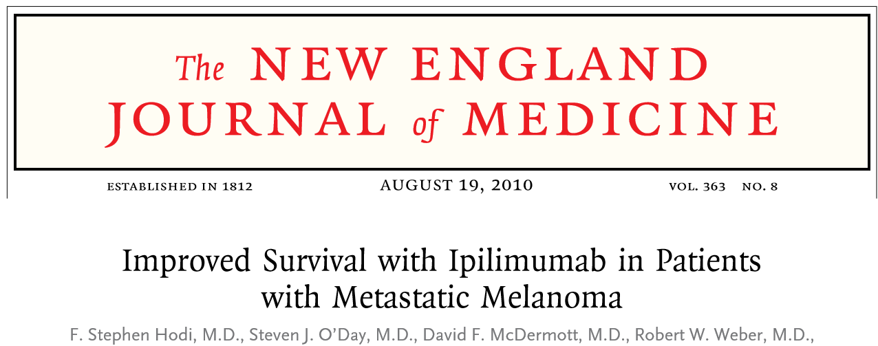
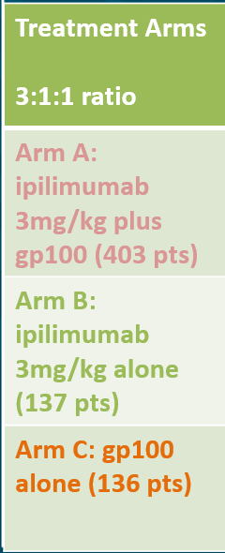
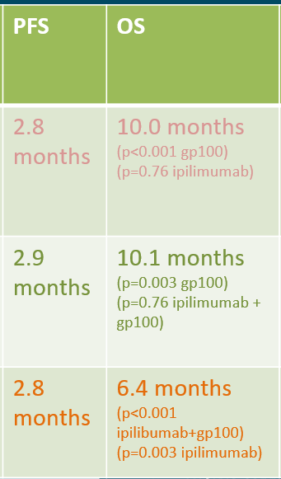
Type of study/Inclusion criteria
Phase III: 676 patients
Unresectable stage III or IV melanoma
Progressive disease after first line therapy (dacarbazine, temozolomide, fotemustide, carboplatin or interleukin-2)
Advanced disease (70% M1c, 10% CNS metastasis)
Treatment Arms 3:1:1 ratio | Objective response | 2 year duration response | PFS | OS | Grade 3-4 immune related AE
Arm A: ipilimumab 3mg/kg plus gp100 (403 pts) | 5.7% (p=0.04 gp100) (p=0.04 ipilimumab) | 17.4% | 2.8 months | 10.0 months (p<0.001 gp100) (p=0.76 ipilimumab) | 10-15%
Arm B: ipilimumab 3mg/kg alone (137 pts) | 10.9% (p=0.001 gp100) (p=0.04 ipilimumab + gp100) | 60.0% | 2.9 months | 10.1 months (p=0.003 gp100) (p=0.76 ipilimumab + gp100) | 10-15%
Arm C: gp100 alone (136 pts) | 1.5% (p=0.04 ipilibumab+gp100) (p=0.001 ipilimumab) | 0% | 2.8 months | 6.4 months (p<0.001 ipilibumab+gp100) (p=0.003 ipilimumab) | 3%
Hodi 2010 NEJM “Improved survival ipilimumab in patients with metastatic melanoma”

Slide 20

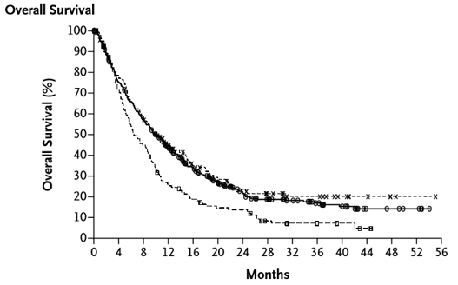
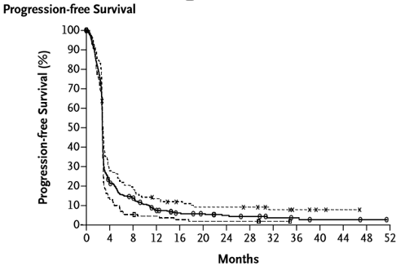
Hodi 2010 NEJM “Improved survival ipilimumab in patients with metastatic melanoma”

Slide 21
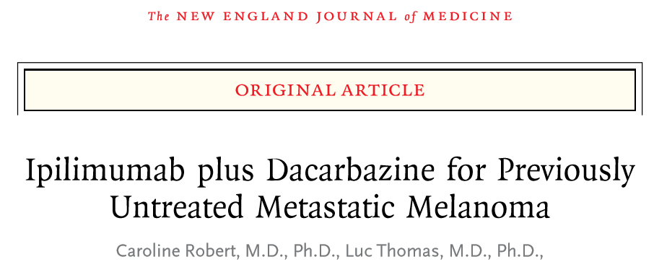
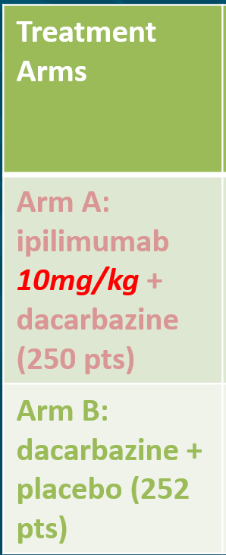
Type of study/Inclusion criteria
Phase III: 502 patients
Unresectable stage III or IV melanoma
FIRST LINE metastatic therapy
Prior adjuvant therapy ~26%
Treatment Arms | Objective response/ CR | Median duration response | OS | Percent completing scheduled four doses | Grade 3-4 irAE/ overall AE
Arm A: ipilimumab 10mg/kg + dacarbazine (250 pts) | 15.2% (p=0.09) CR: 1.6%* | 19.3 months (p=0.03) | 11.2 months (p<0.001) | 36.8% (Of the 64% who stopped: -34% due to AE) | 38% irAE 56.3% AE
Arm B: dacarbazine + placebo (252 pts) | 10.3% (p=0.09) CR: 0.8% | 8.1 months (p=0.03) | 9.1 months (p<0.001) | 65.5% (Of the 34% who stopped: -4% due to AE) | 4% irAE 27.5% AE
*Some patients had a progression to complete response NOT CAPTURED
Robert 2011 NEJM “Ipilimumab plus dacarbazine for previously untreated metastatic melanoma”

Slide 22
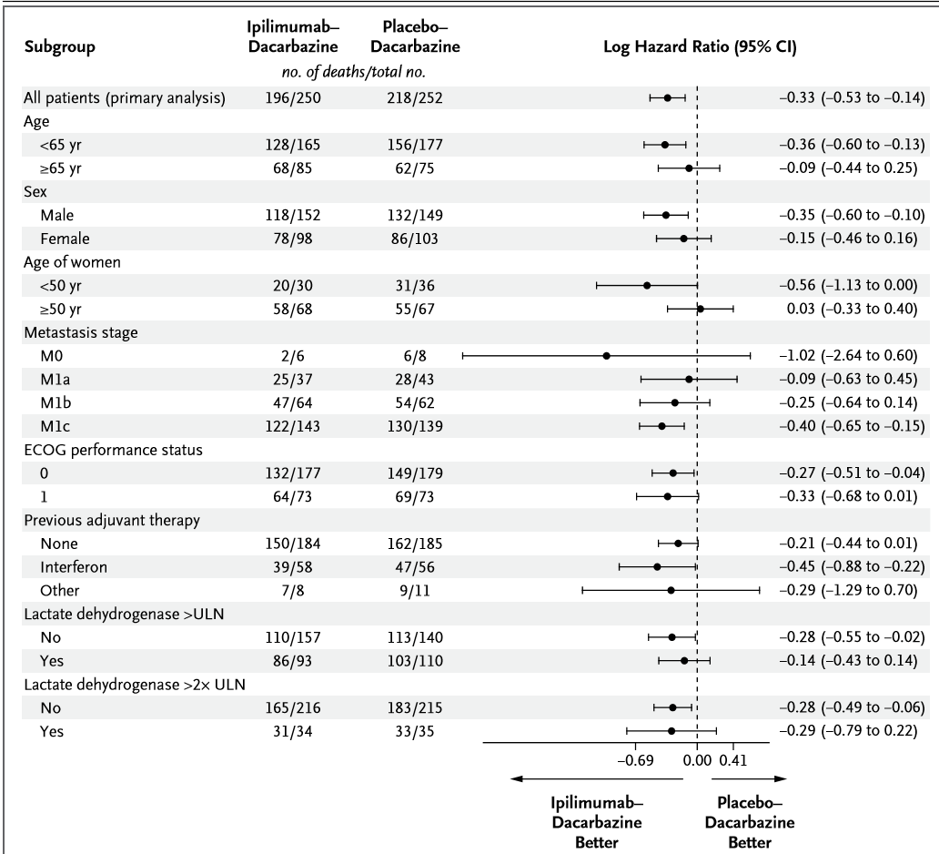
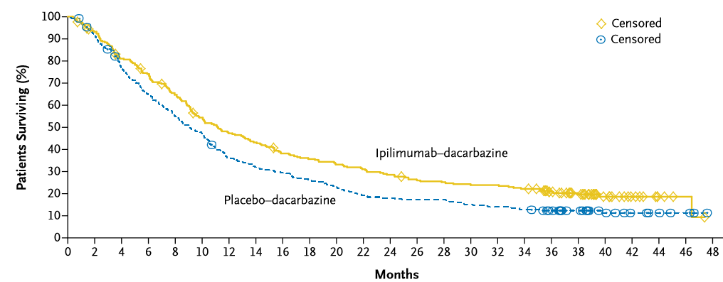
Overall survival | Ipilimumab-dacarbazine | Dacarbazine-placebo
1 year | 47.3% | 36.3%
2 years | 28.5% | 17.9%
3 years | 20.8% | 12.2%
Robert 2011 NEJM “Ipilimumab plus dacarbazine for previously untreated metastatic melanoma”

Slide 23

Side effects:
Dose dependent 10mg/kg
ANY adverse events
→99%*
*what was going on with that 1 person??
Grade 3 or 4 adverse events
→54%
Fatigue (30%)
Diarrhea (10%)
AST/ALT (5%/3%)
Immune-related events
→92%
Dermatological 59%
GI 30%
Endocrine 29%
Hepatic 14%
Neurologic 3%
Eggermont, Lancet 2010 Adjuvant ipilimumab versus placebo after complete resection of high-risk stage III melanoma (EORTC 18071): a randomized, double-blind, phase 3 trial
Side effects:
Dose dependent 3mg/kg
ANY adverse events
→96.9%
Grade 3 or 4 adverse events
→46% of patients with grade 3 or 4 side effects
Diarrhea (5.3%)
Fatigue (6.9%)
Immune-related events
→61%
Dermatologic 44%
GI 29%
Endocrine 7.6%
Hepatic 3.8%
Hodi 2010 NEJM “Improved survival ipilimumab in patients with metastatic melanoma”

Slide 24
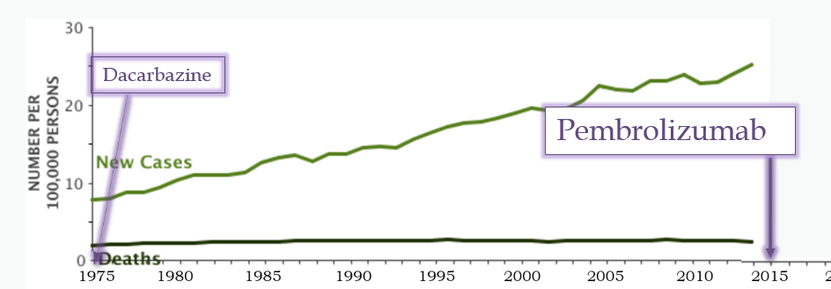
Pembrolizumab
An antibody against programmed-death-receptor-1 (PD-1), a checkpoint inhibitor
FDA approved in 2015 for unresectable or metastatic stage III or IV melanoma based on three KEYNOTE trials (phase I, II, and III):
-Robert 2014 Lancet “Anti-programmed death-receptor-1 treatment with pembrolizumab in ipilimumab-refractory advanced melanoma: a randomized dose-comparison cohort of a phase 1 trial”
-Ribas 2015 Lancet “Pembrolizumab versus investigator-choice chemotherapy for ipilimumab-refractory melanoma (KEYNOTE-002): a randomized, controlled, phase 2 trial”
-Robert 2015 NEJM “Pembrolizumab versus Ipilimumab in Advanced Melanoma”
-Schachter 2017 Lancet ““Pembrolizumab versus Ipilimumab in Advanced Melanoma: final overall survival results of a multicenter, randomized, open-label phase 3 study (KEYNOTE-006)

Slide 25

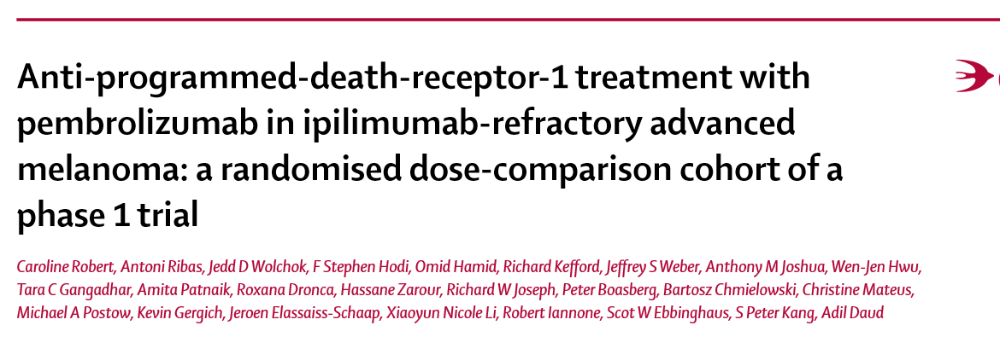
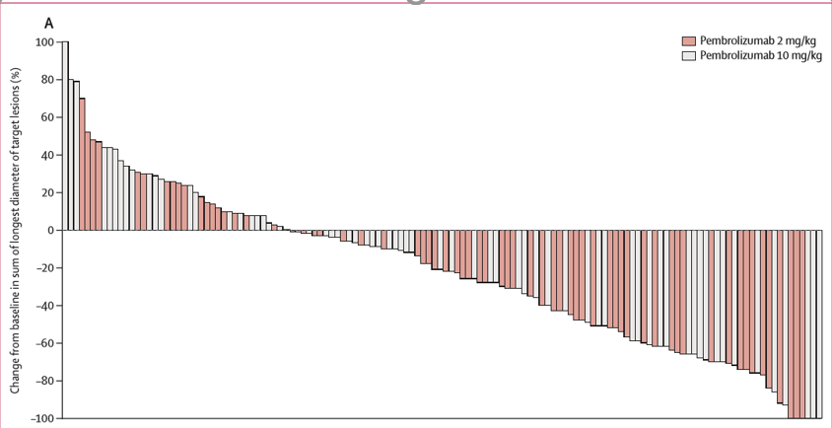
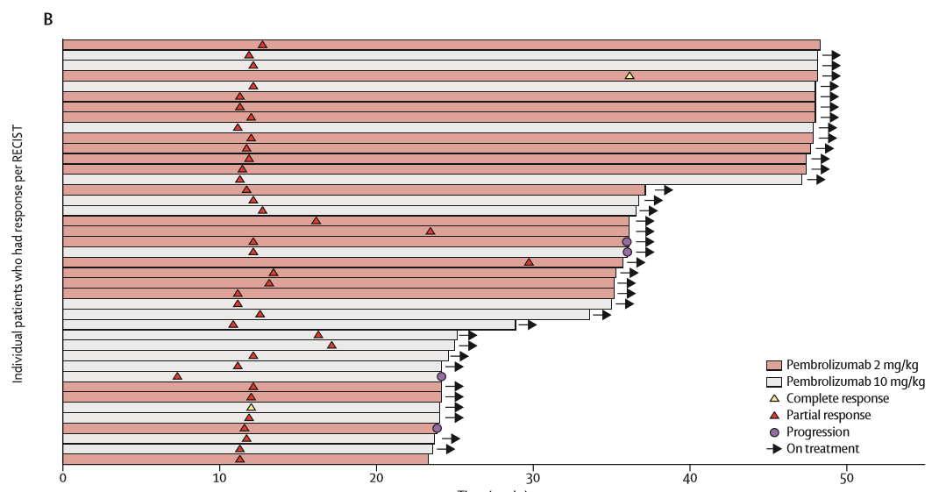
KEYNOTE-001
Type of study/Inclusion criteria
Phase I: RCT, 173 patients
Ipilimumab-refractory, and BRAF/MEK-refractory if BRAF positive
Unresectable stage III or IV melanoma
Treatment Arms | Overall response rate | Disease control rate | Median PFS | OS at 1 year | Grade 3-4 AE
Pembrolizumab 2mg/kg (89 pts) | 26% (p=0.96) | 51% (p=0.94) | 22 wks/5.1 months (CI: 12-36 weeks) | 58% (CI: 47-68%) | 15%
Pembrolizumab 10mg/kg (84 pts) | 26% (p=0.96) | 50% (p=0.94) | 14 wks/3.2 months (CI=12-24 weeks) | 63% (CI: 51-71%) | 8%
Robert 2014 Lancet “Anti-programmed death-receptor-1 treatment with pembrolizumab in ipilimumab-refractory advanced melanoma: a randomized dose-comparison cohort of a phase 1 trial”

Slide 26
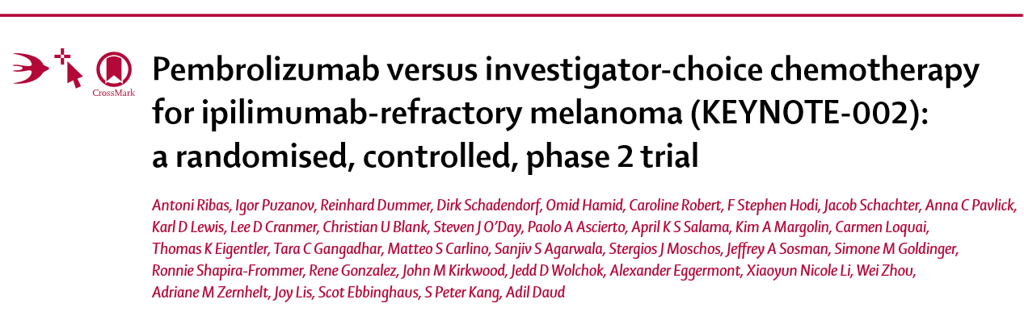
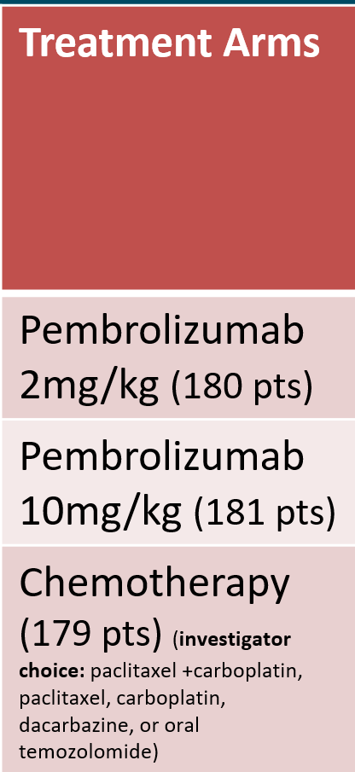
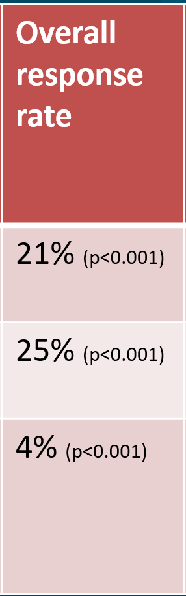
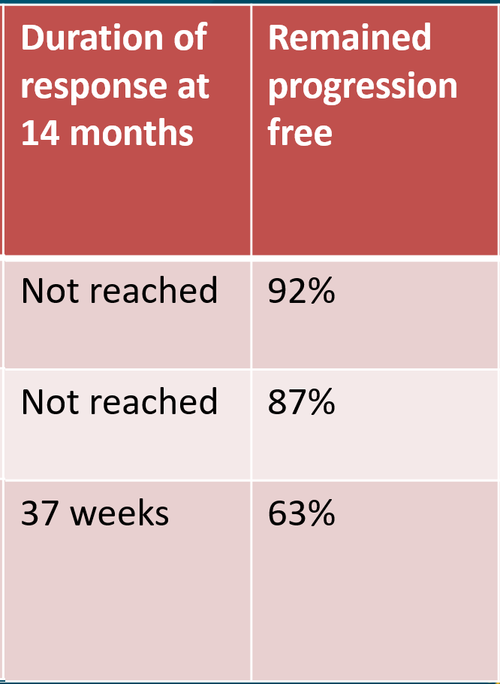
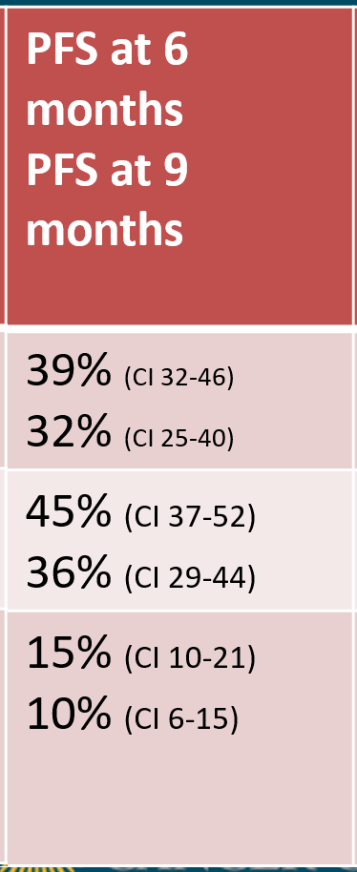
KEYNOTE-002
Type of study/Inclusion criteria
Phase II: RCT, 540 patients
Ipilimumab-refractory, and BRAF/MEK-refractory if BRAF positive
Unresectable stage III or IV melanoma
**OS will be reported once 370 deaths occur
Treatment Arms | Overall response rate | Duration of response at 14 months | Remained progression free | PFS at 6 months PFS at 9 months | Grade 3-4 AE/ QLQ score
Pembrolizumab 2mg/kg (180 pts) | 21% (p<0.001) | Not reached | 92% | 39% (CI 32-46) 32% (CI 25-40) | 11% -2.60
Pembrolizumab 10mg/kg (181 pts) | 25% (p<0.001) | Not reached | 87% | 45% (CI 37-52) 36% (CI 29-44) | 14% -2.55*
Chemotherapy (179 pts) (investigator choice: paclitaxel +carboplatin, paclitaxel, carboplatin, dacarbazine, or oral temozolomide) | 4% (p<0.001) | 37 weeks | 63% | 15% (CI 10-21) 10% (CI 6-15) | 26% -9.13* *statistically significant
Ribas 2015 Lancet “Pembrolizumab versus investigator-choice chemotherapy for ipilimumab-refractory melanoma (KEYNOTE-002): a randomized, controlled, phase 2 trial”

Slide 27
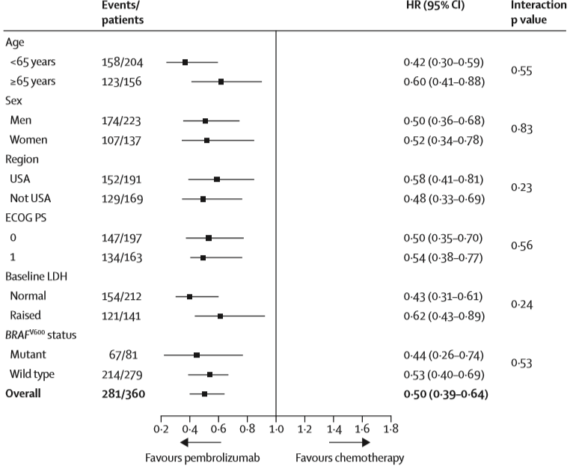
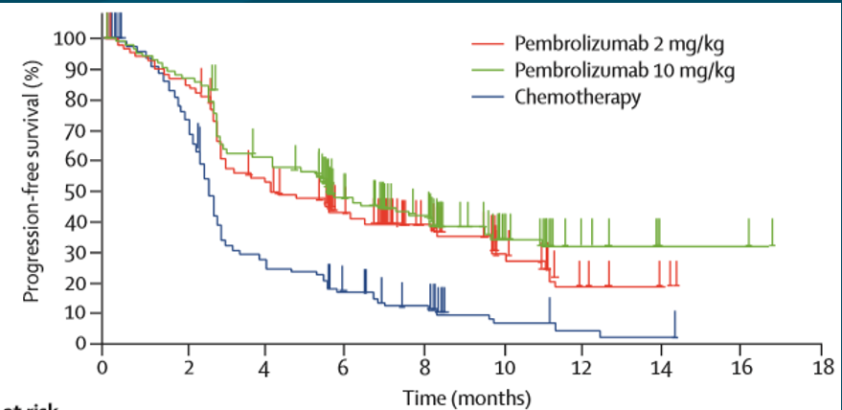
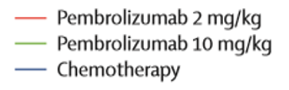

Ribas 2015 Lancet “Pembrolizumab versus investigator-choice chemotherapy for ipilimumab-refractory melanoma (KEYNOTE-002): a randomized, controlled, phase 2 trial”

Slide 28
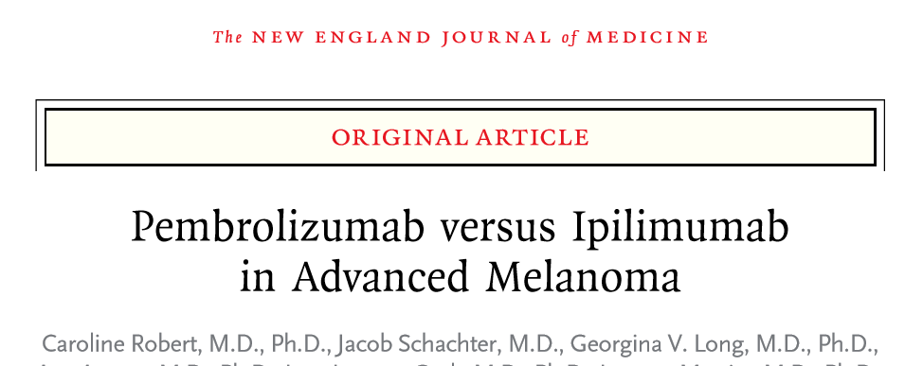
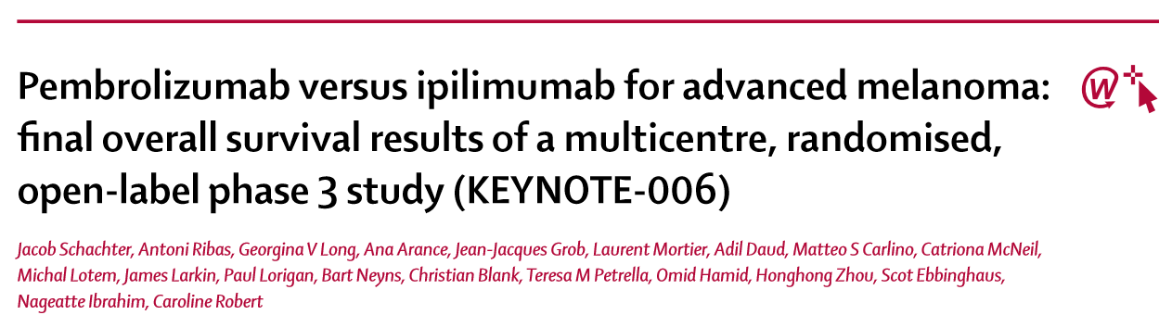
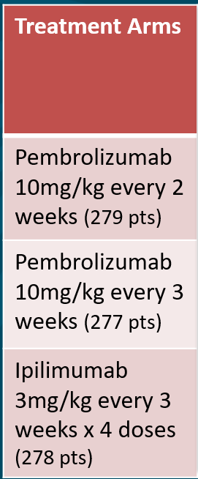
KEYNOTE-006
Type of study/Inclusion criteria
Phase III: RCT, 834 patients
Ipilimumab naive unresectable stage III or IV melanoma
No more than one previous treatment
BRAF inhibitor not required prior to treatment
Treatment Arms | Overall response rate | Complete response rate | Median duration of response at ~2 years | PFS at 6 months | OS at: 1 year 2 years Median OS | Grade 3-4 AE*
Pembrolizumab 10mg/kg every 2 weeks (279 pts) | 33.7% (p<0.001) 37% | ~1 yr: 5.0% ~2 yrs: 12% | NR (1.8->22.8) | 47.3% (p<0.001 compared to ipilimumab) | 1 yr:74.1% (p=0.0005) 2 yr: 55% Median: NR by ~2 yrs | 13.3% 17%
Pembrolizumab 10mg/kg every 3 weeks (277 pts) | 32.9% (p<0.001) 36% | ~1 yr: 6.1% ~2 yrs: 13% | NR (2.0->22.8) | 46.4% (p<0.001 compared to ipilimumab) | 1 yr: 68.4% (p=0.0036) 2 yr: 55% Median:NR by ~2 yrs | 10.1% 17%
Ipilimumab 3mg/kg every 3 weeks x 4 doses (278 pts) | 11.9% (p<0.001) 13% | ~1 yr: 1.4% ~2 yrs: 5% | NR (1.1->22.8) | 26.5% (p<0.001 compared pembrolizumab arms) | 1 yr:58.2% (p= 2 yr: 43% Median:16 months | 19.9% 20%
-Robert 2015 NEJM “Pembrolizumab versus Ipilimumab in Advanced Melanoma”
-Schachter 2017 Lancet “Pembrolizumab versus Ipilimumab in Advanced Melanoma: final overall survival results of a multicenter, randomized, open-label phase 3 study (KEYNOTE-006)”

Slide 29
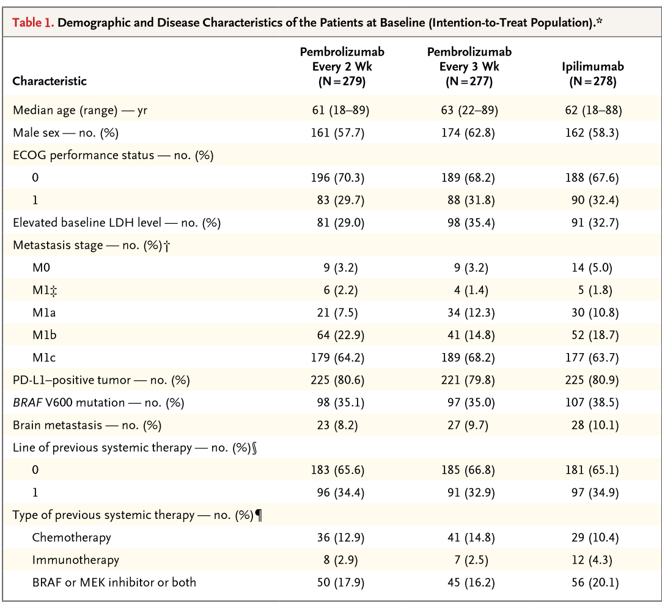
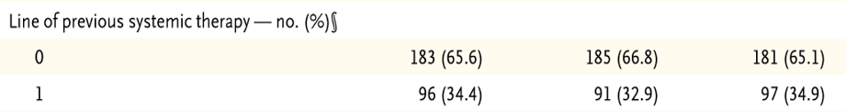
*~50% of BRAF mutations received BRAF/MEK inhibitors
-Robert 2015 NEJM “Pembrolizumab versus Ipilimumab in Advanced Melanoma”
-Schachter 2017 Lancet “Pembrolizumab versus Ipilimumab in Advanced Melanoma: final overall survival results of a multicenter, randomized, open-label phase 3 study (KEYNOTE-006)”

Slide 30
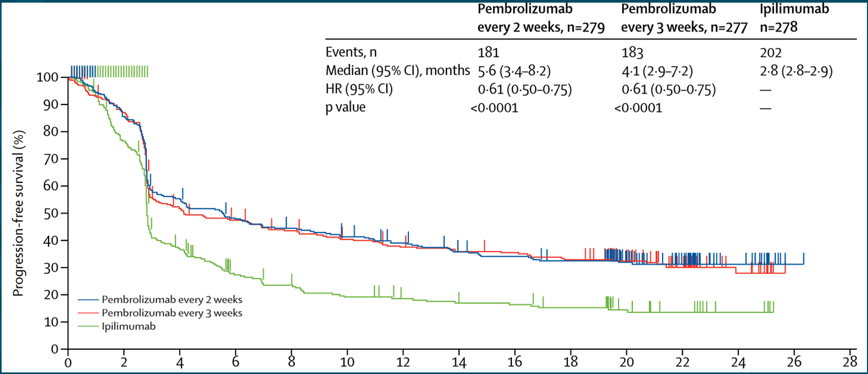
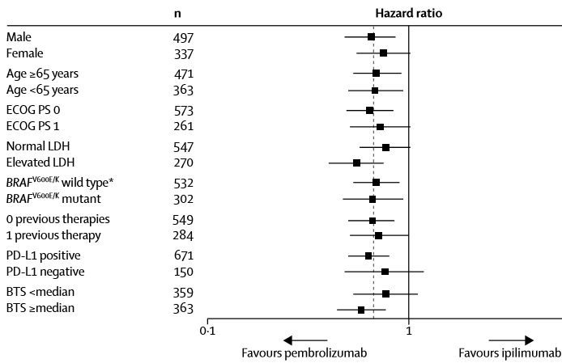
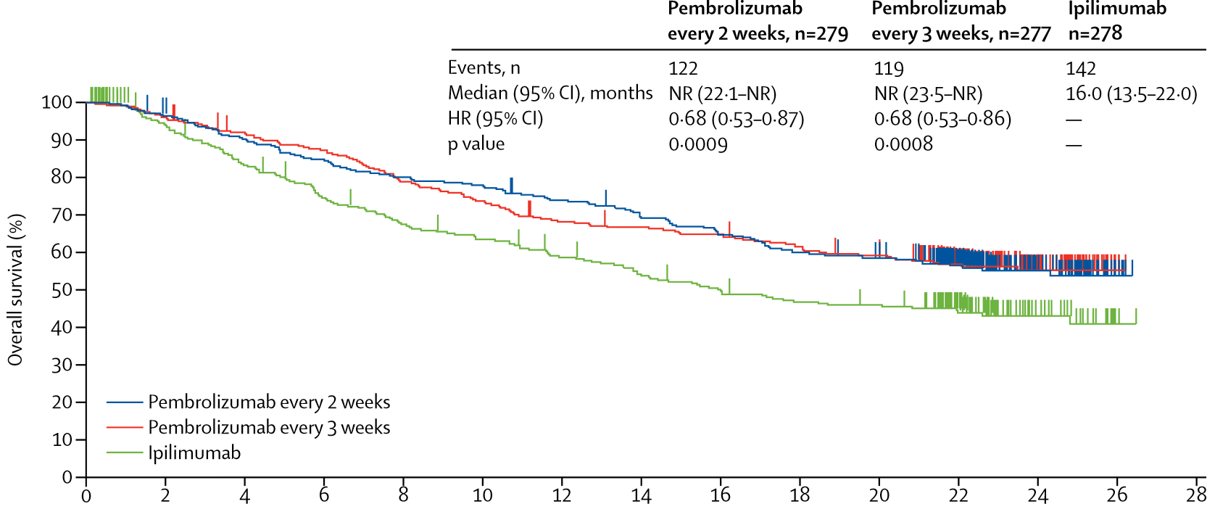

*30% of the ipilimumab arm received subsequent anti-PD-1 therapy
-Robert 2015 NEJM “Pembrolizumab versus Ipilimumab in Advanced Melanoma”
-Schachter 2017 Lancet “Pembrolizumab versus Ipilimumab in Advanced Melanoma: final overall survival results of a multicenter, randomized, open-label phase 3 study (KEYNOTE-006)”

Slide 31
Side effects:
ANY adverse events
→77-82%
Fatigue (23-28%)
Puritis (20%)
Diarrhea (17-19%)
Rash (16-17%)
Arthralgias (13%)
Nausea (13%)
Hypothyroidism (11%)
Lead to discontinuation
→7-11%
Grade 3 or 4 adverse events
→17%
Fatigue (~1%)
Diarrhea (3%)
Hepatitis (1.1-1.8%)
Schachter 2017 Lancet “Pembrolizumab versus Ipilimumab in Advanced Melanoma: final overall survival results of a multicenter, randomized, open-label phase 3 study (KEYNOTE-006)”

Slide 32

Nivolumab
A fully human IgG4 antibody against programmed-death-receptor-1 (PD-1), a checkpoint inhibitor
FDA approved in 2015 for unresectable or metastatic stage III or IV melanoma based on three phase III trials:
-Robert 2015 NEJM “Nivolumab in previously untreated melanoma without BRAF mutation
-Weber 2015 Lancet “Nivolumab versus chemotherapy in patients with advanced melanoma who progressed after antiCTLA-4 treatment (CheckMate 037): a randomized, controlled, open-label, phase 3 trial”
-Larkin 2015 NEJM “Combined Nivolumab and Ipilimumab or monotherapy in untreated melanoma”

Slide 33


CheckMate 066
Type of study/Inclusion criteria
Phase III: RCT, 418 patients
Ipilimumab-naive/treatment (except adjuvant)-naive
Without BRAF mutation
Unresectable stage III or IV melanoma
Treatment arms | Overall response rate | Complete response | PFS | OS at 1 year | Grade 3-4 AE
Nivolumab 3mg/kg every 2 weeks (210 pts) | 40.0% (CI 33.3-47.0 %) | 7.6% | 5.1 months (p<0.001) | 72.9% (CI 65.5-78.9%) | 11.7%
Dacarbazine 1000 mg/m2 every 3 weeks (208 pts) | 13.9% (CI 9.5-19.4 %) | 1.0% | 2.2 months (p<0.001) | 42.1% (CI 33.0-50.9%) | 17.6%
Robert 2015 NEJM “Nivolumab in previously untreated melanoma without BRAF mutation”

Slide 34


CheckMate 037
Type of study/Inclusion criteria
Phase III: RCT, 405 patients
Ipilimumab/BRAF (if BRAF mutated)-treated
Unresectable stage III or IV melanoma
Treatment arms (2:1) | Overall response rate | Complete response | Response duration | PFS | Median OS | Grade 3-4 AE
Nivolumab 3mg/kg every 2 weeks (272 pts) | 31.7% (CI 23.5-40.8 %) | 6% | 31.9 months (3.25.9-31.9) | 4.7 months (CI 2.3-6.5) | 15.7 months (HR 0.95 CI 0.73-1.24) | 24 mo 9% 2yrs 14%
Chemotherapy (dacarbazine or paclitaxel + carboplatin) (133 pts) | 10.6% (CI 3.5-23.1 %) | 1% | 12.8 months (3.0-not reached) | 4.2 months (CI 2.1-6.3) | 14.4 months (HR 0.95 CI 0.73-1.24) | 24 mo 31% 2 yrs 34%
Weber 2015 Lancet “Nivolumab versus chemotherapy in patients with advanced melanoma who progressed after antiCTLA-4 treatment (CheckMate 037): a randomized, controlled, open-label, phase 3 trial”
Larkin 2017 JCO “Overall survival in patients with advanced melanoma who received nivolumab versus investigator's choice chemotherapy in CheckMate 037 A randomized, controlled, open-label phase III trial”

Slide 35



Nivolumab
Withdrew consent=1
Chemotherapy
Withdrew consent=16
Weber 2015 Lancet “Nivolumab versus chemotherapy in patients with advanced melanoma who progressed after antiCTLA-4 treatment (CheckMate 037): a randomized, controlled, open-label, phase 3 trial”
Larkin 2017 JCO “Overall survival in patients with advanced melanoma who received nivolumab versus investigator's choice chemotherapy in CheckMate 037 A randomized, controlled, open-label phase III trial”

Slide 36
Treatment Side effects:
ANY adverse events
→77%
Fatigue (32%)
Prutitis (22%)
Diarrhea (18%)
Rash (13%)
Nausea (12%)
Vitiligo (11%)
Lead to discontinuation
→5%
Grade 3 or 4 adverse events
→14%
Fatigue (1%)
Anemia (1%)
AST/ALT elevation (1%)
Larkin 2017 JCO “Overall survival in patients with advanced melanoma who received nivolumab versus investigator's choice chemotherapy in CheckMate 037 A randomized, controlled, open-label phase III trial”

Slide 37





CheckMate 067
Type of study/Inclusion criteria
Phase III: RCT, 945 patients
Untreated patients
Unresectable stage III or IV melanoma
Treatment arms | Overall response rate | Complete response | PFS | Median OS updated from ASCO 2017 | Grade 3-4 AE
Nivolumab 3mg/kg every 2 weeks (316 pts) | 43.7% (p <0.001* ipilimumab alone) | 8.9% | 6.9 months (p<0.001* ipi) (HR 0.74 CI 0.60-0.92**ipi/nivol) | 31.1 months (p<0.001) | 16.3%
Nivolumab 1mg/kg + Ipilimumab 3mg/kg every 3 weeks x 4 doses → Nivolumab 3mg/kg every 2 weeks (314 pts) | 57.6% (p<0.001* ipilimumab alone) | 11.5% | 11.5 months (p<0.001* ipi) (HR 0.74 CI 0.60-0.92**Nivolumab) | Not reached, but 2 year OS: 63.8% (p<0.001) | 55.0%
Ipilimumab 3mg/kg every 3 weeks x 4 doses (315 pts) | 19.0% (p<0.001* Nivolumab arms) | 2.2% | 2.9% (p<0.001* ipilimumab alone) | 18.2 months | 27.3%
Larkin 2015 NEJM “Combined Nivolumab and Ipilimumab or monotherapy in untreated melanoma + updated OS data from ASCO 2017

Slide 38


Larkin 2015 NEJM “Combined Nivolumab and Ipilimumab or monotherapy in untreated melanoma + updated OS data from ASCO 2017

Slide 39




* In PD-L1 negative tumors, PFS longer in the Nivolumab/Ipilimumab group than Nivolumab alone (11.2 months [8-NR] vs 5.3 months [2.8-7.1])
Larkin 2015 NEJM “Combined Nivolumab and Ipilimumab or monotherapy in untreated melanoma + updated OS data from ASCO 2017

Slide 40






** based on a phase III study “Adjuvant ipilimumab versus placebo after complete resection of high risk stage III melanoma EORTC 18071 a randomized double blind phase 3 trial”

Slide 41

Treatment arms | PFS overall | PFS positive sentinel nodes | PFS palpable nodes | OS | Grade 3-4 AE
Ipilimumab 10mg/kg every 3 weeks x 4 doses →10mg/kg every 3 months (475 pts) | 26.1 months (p=0.0013) | Not reached (p=0.004) | 15.4 months (p=0.06) | Not reached | 55% 52% of pts discontinued due to adverse events 1% (5 pts) died due to treatment
Placebo (476 pts) | 17.1 months (p=0.0013) | 26.9 months (p=0.004) | 11.3 months (p=0.06) | Not reached | 26%
Eggermont 2015 Lancet “Adjuvant ipilimumab versus placebo after complete resection of high risk stage III melanoma EORTC 18071 a randomised double blind phase 3 trial”

Slide 42


Only those with more aggressive disease had a true progression free survival benefit
Eggermont 2015 Lancet “Adjuvant ipilimumab versus placebo after complete resection of high risk stage III melanoma EORTC 18071 a randomised double blind phase 3 trial”

Slide 43


55% with grade 3-4 toxicities
52% of pts discontinued due to adverse events
1% (5 pts) died due to treatment
Eggermont 2015 Lancet “Adjuvant ipilimumab versus placebo after complete resection of high risk stage III melanoma EORTC 18071 a randomised double blind phase 3 trial”

Slide 44

FUTURE DIRECTIONS

Slide 45

Ongoing Phase III Trials for Stage III Malignant Melanoma after complete resection.

Slide 46



Double-blind, placebo controlled, phase III trial
870 pt with completely resected stage III melanoma with BRAF V600E or V600K
Dabrafenib/Trametinib vs. placebo for 1 year
3 year relapse free survival was 58% in combination group vs. 39% in placebo (p<0.001)
3 year overall survival was 86% in combination group vs. 77% in placebo

Slide 47



Double-blind, placebo controlled, phase III trial
906 pt with completely resected stage III melanoma
Nivolumab 3mg/kg every 2 weeks vs. ipilimumab 10mg/kg every 3 weeks x 4 doses then every 12 weeks up to 1 year
12 month RFS 70.5% in the Nivolumab groups and 60.8% in ipilimumab group (p<0.001)
Treatment related 3-4 adverse events were 14.4% in Nivolumab and 45.9% in ipilimumab

Slide 48




Slide 49

Failed combination:
HIGH PROFILE Phase III Trials for unresectable Stage III or IV Malignant Melanoma.
Minor 2015 Pigment Cell Melanoma Res “Severe gastrointestinal toxicity with administration of trametinib in combination with dabrafenib and ipilimumab”

Slide 50
Ongoing phase III trials:
PDR001 + Dabrafenib/Trametinib in untreated, unresected advanced melanoma (NCT02967692) | KEYNOTE-252/ECHO-301 Pembrolizumab + Epacadostat or Placebo in unresectable or metastatic melanoma (NCT02752074)
PDR001 is a high-affinity, ligand-locking, humanized anti-PD-1 IgG4 antibody that blocks the binding of PD-L1 and PD-L2 | Epacadostat, is a idoleamine 2,3-dioxygenase 1 (IDO1) inhibitor, which suppresses T-cell response and allows for immune tolerance
Enrollment: 538 pts | Enrollment: 706 pts
Estimated Primary Completion: 07/2019 Final Completion: 12/2019 | Estimated Primary Completion: 05/2018 Final Completion: 04/2019

Slide 51
Ongoing phase III trials:
TRILOGY: Atezolizumab + Cobimetinib/Vemurafenib vs Placebo + Cobimetinib/Vemurafenib in untreated BRAF mutated, unresectable melanoma (NCT02908672) | KEYNOTE-034/MASTERKEY-265: Pembrolizumab + T-VEC vs. Placebo T-VEC in untreated, unresected melanoma (NCT02263508)
Atezolizumab is a humanized engineered monoclonal antibody against PD-L1 | Talimogene Laherparepvec (T-VEC) is a herpes simplex virus that selectively replicates in tumors, produces GM-CSF and stimulates antitumor immune responses in melanoma
Phase I/II studies showed ORR: 83% with 10% CR, 72% PR | Phase I/II ORR: 48%, CR: 14%
Enrollment: 500 pts | Enrollment: 660 pts
Estimated Primary Completion: 11/2019 Final Completion: 11/2019 | Estimated Primary Completion: 12/2018 Final Completion: 09/2022

Slide 52





How long should we continue PD-1 inhibitor therapy?
What is the ideal combination of Nivolumab + Ipilimumab?

Slide 53


